Slide 1
CYBERSECURITY AWARENESS · 01
AI VOICE-CLONING
SCAMS
When Your Family's Voice Can Be Faked
The voice sounds real. But is it really them?
Name: K.Gopala krishna
Roll Number:261FB04015

Slide 2




THE FIRST REACTION
Would you trust the voice?
A caller sounds exactly like your mother, father, brother, or sister.
They sound frightened and urgently ask for money.
They tell you not to inform anyone.
Would you trust the voice before checking the story?
02

Slide 3



HOW THE TECHNOLOGY WORKS
AI voice cloning turns a voice sample into convincing new speech
Voice sample
AI model
Cloned speech
AI learns tone, accent, rhythm, and speaking style from recorded audio.
Depending on the technology and recording quality, relatively short samples may be enough.
The system produces new speech that resembles the original speaker.
AUDIO SAMPLE → AI MODEL → CLONED VOICE
03

Slide 4
THE SCAM PIPELINE
Three steps from a recording to a fake call
Collect
Learn
Generate
Gather audio from videos, social media, voice messages, or other recordings.
Analyze the characteristics that make the speaker sound like themselves.
Produce new speech that resembles the original speaker.
Recording becomes a voice that can deliver a new story.
04

Slide 5




THE STORY AROUND THE VOICE
Scammers pair a familiar voice with a believable story
Family emergency
Financial impersonation
A relative is supposedly arrested, injured, or kidnapped.
A business owner or manager requests an urgent transfer.
Fake authority
Targeted social engineering
A trusted official or representative appears to be calling.
Personal information makes the story feel real.
05

Slide 6





WHY THE SCAM FEELS REAL
Fear makes a fake voice feel like proof
Familiar voices trigger trust and emotional reactions.
Fear and urgency reduce careful decision-making.
Secrecy blocks outside verification.
Personal details make a fabricated emergency feel genuine.
A familiar voice is not proof of identity.
06

Slide 7
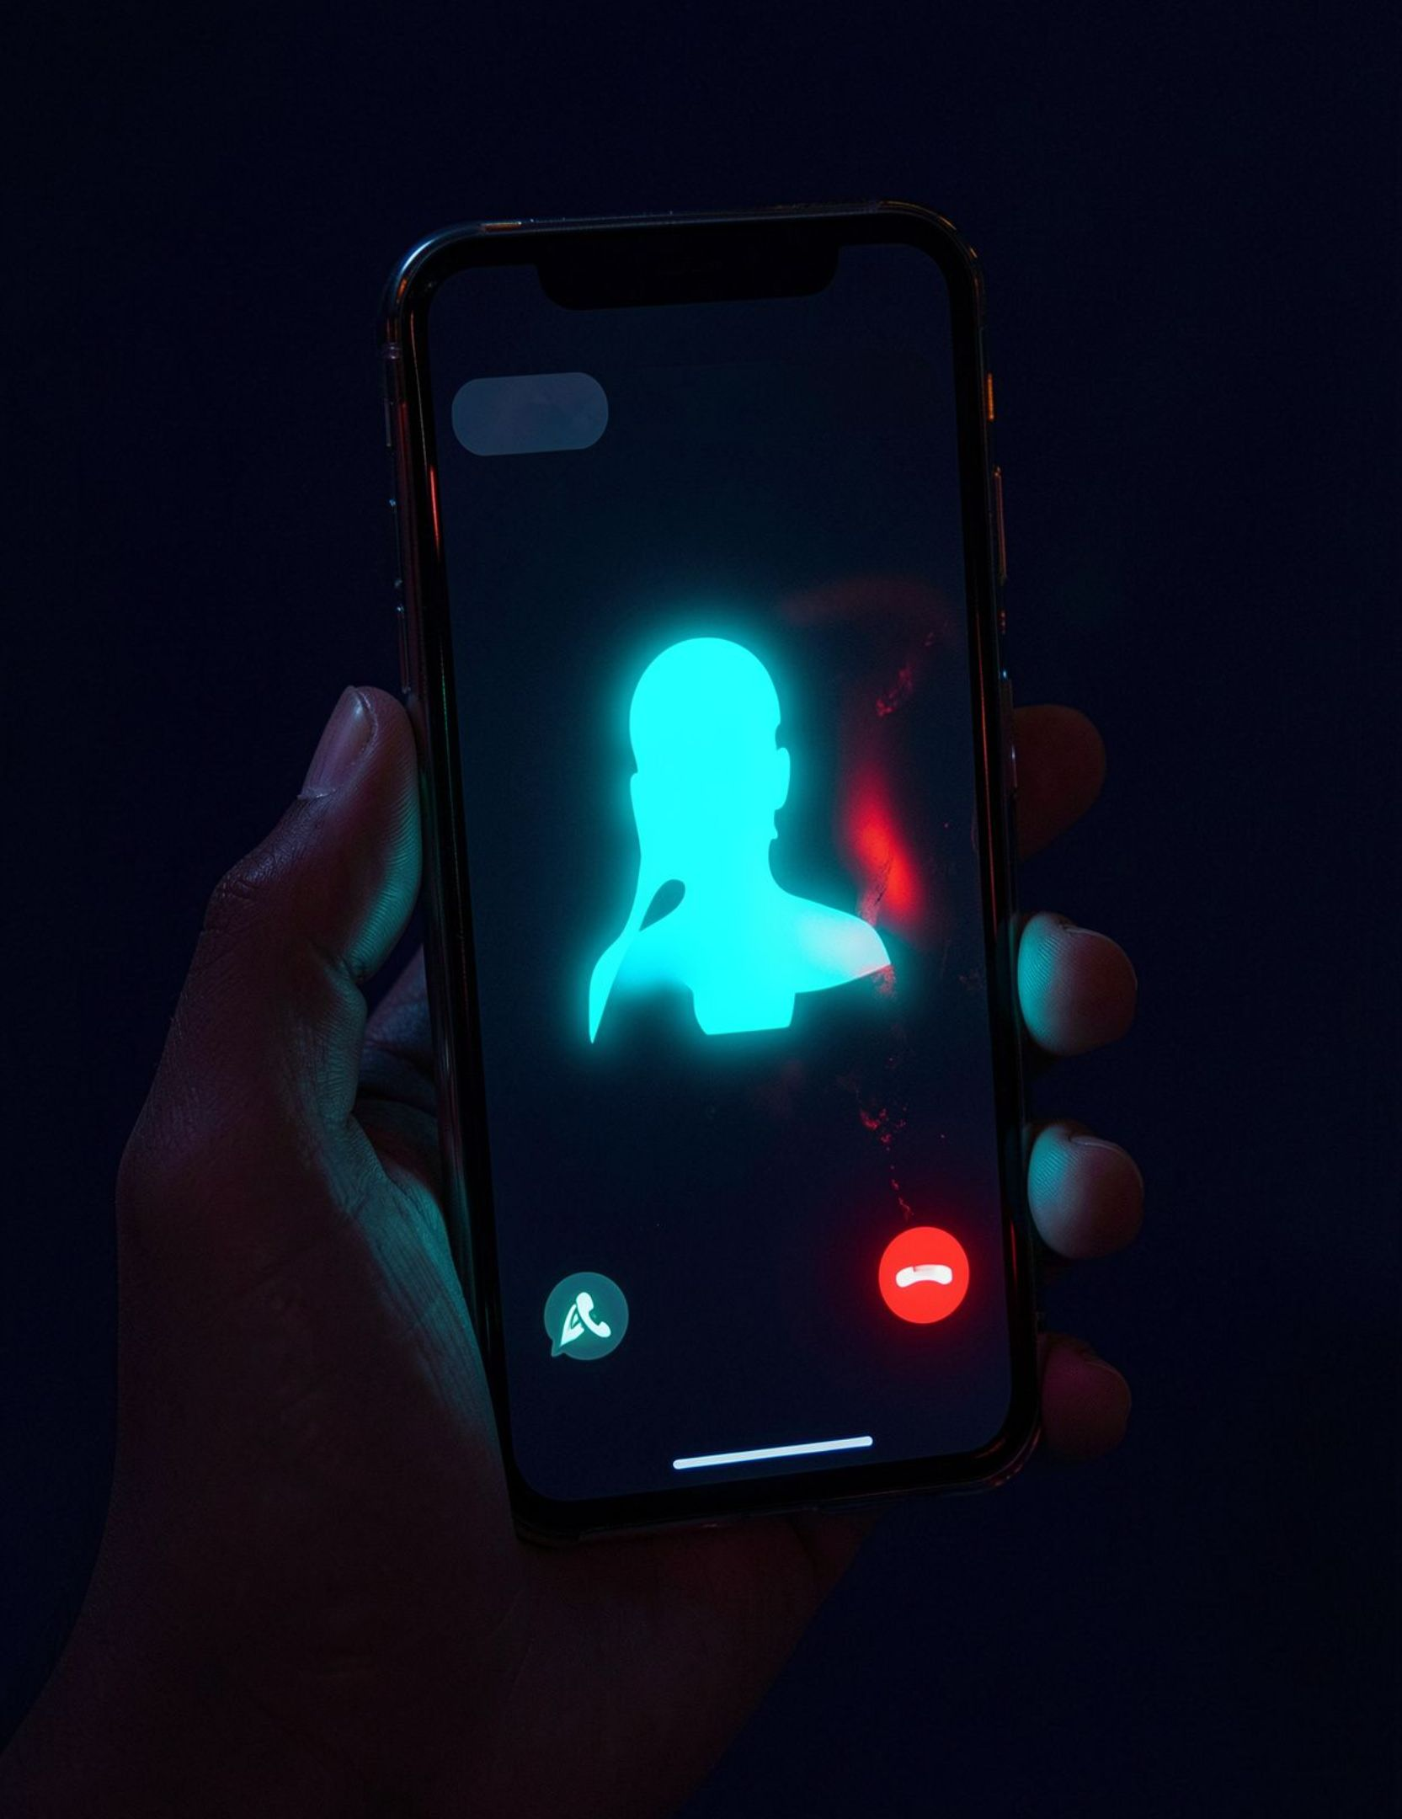
THE MOMENT TO INTERRUPT
Warning signs appear before the money moves
Unexpected emergency involving a loved one.
Immediate demand for money or gift cards.
Request to keep the call secret.
Pressure to act before verifying the story.
Unusual transfer method or payment channel.
07

Slide 8
MAKE VERIFICATION AUTOMATIC
Build a verification habit before the crisis
01
02
03
Call back
Use a code word
Ask another person
Hang up and call back using a number you already trust.
Establish a family code word or phrase.
Contact another trusted family member independently.
04
05
06
Verify first
Share carefully
Financial decisions
Verify emergency claims before sending money.
Share sensitive personal or voice information carefully.
Never rely on voice recognition alone for financial decisions.
08

Slide 9
IF THE CALL HAS ALREADY HAPPENED
If you are targeted, slow the chain down
01
02
03
04
Stop
Verify
Contact bank
Preserve evidence
Pause the transaction and independently verify the caller.
Use a trusted number or another family member.
Act immediately if money has been transferred.
Save calls, messages, payment records, and related information.
REPORT
CALL 1930
India's official cybercrime reporting portal: https://cybercrime.gov.in
India's cybercrime helpline, particularly for financial cyber fraud.
Recovery of transferred money is not guaranteed, so speed matters.
09

Slide 10

THE HABIT TO KEEP
Trust the person. Verify the voice.
AI can imitate a voice, but verification protects the people you care about.
Pause before reacting.
Verify through another channel.
Never send money based only on a voice.
Thank You

